Slide 1

DEEP LEARNING FOR TERRAIN RECOGNITION
Under the guidance of :-
Dr. Hemant Turkar
[ASSOCIATE PROFESSOR]

Slide 2
OVERVIEW
Introduction
Objectives
Methodology
Expected Outcomes
Challenges
Research Papers related to topic
Have a look on it….!

Slide 3
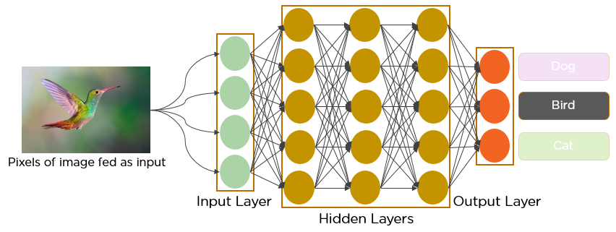

INTRODUCTION
Deep learning methods have been applied in identifying landform types due to their strong feature learning capacity. Nevertheless, current works using deep learning in geomorphology mostly have focused on identifying component landform elements, and there is a lack of work on mapping repeating landform types.
Grass
Rock
Snowy

Slide 4
OBJECTIVES AND METHODOLOGY
Objectives:
Develop a deep learning model for terrain classification.
Achieve high accuracy in identifying various terrain.
Design models that can adapt to changing terrain conditions over time.
Achieve real-time performance to support time-sensitive applications like autonomous vehicles or drones.
Methodology:
Utilize convolution neural networks(CNNs) and recurrent neural networks(RNNs) to process and analyze terrain features from sensor data, providing a comprehensive understanding of the environment.

Slide 5
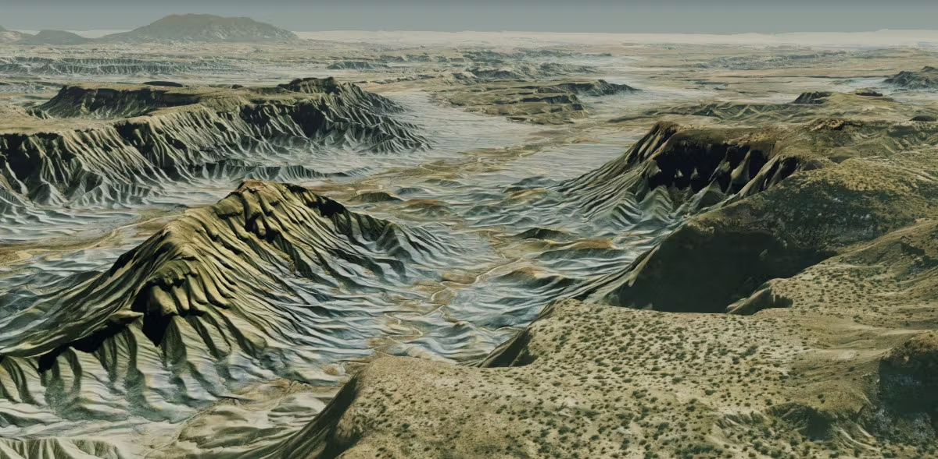
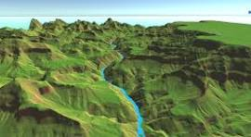
User Input
Upload Picture
Preprocessing
Model
Analysis
Prediction

Slide 6
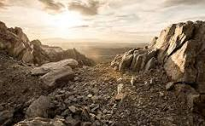
EXPECTED OUTCOMES
Improved accuracy
Real-time Recognition
Adaptability to Diverse Condition
Reduced False positive and negatives
User friendly Interface
Generalization across sensor input
Contribution to research community

Slide 7
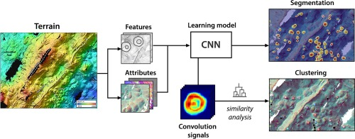
CHALLENGES
Data collection and labeling
Model complexity and training time
Environmental Variability
Feature extraction and Representation
Handling Noisy data
Continuous Learning and Adaptation

Slide 8
RESEARCH PAPERS
Title: Automated terrain feature identification from remote sensing imagery: a deep learning approach
Authors: Wenwen Li and Chia-Yu Hsu
Published online: 07 Nov 2018
Title: Deep learning as applied in SAR target recognition and terrain classification
Authors: X Feng, W Haipeng, J Yaqiu
Title: Deep texture manifold for ground terrain recognition
Authors: J Xue, H Zhang, K Dana Published online: 2018
Title: Deep neural networks for terrain recognition task
Authors: P Kozlowski, K Walas Published online: 2018
Title: A deep learning approach for optical autonomous planetary relative terrain navigation
Authors: T Campbell, R Furfaro, R Linares, D Gaylor Published online: 2017

Slide 9
BIBLIOGRAPHY
https://www.sciencedirect.com/science/article/pii/S1569843223000717#:~:text=Researchers%20have%20employed%20deep%20learning,using%20imagery%20and%20DEM%20data.
https://iopscience.iop.org/article/10.1088/1742-6596/1693/1/012128/pdf#:~:text=for%20Image%20Recognition-,Deep%20learning%20is%20widely%20used%20in%20image%20recognition%20due%20to,noticeable%20effect%20on%20image%20recognition.
https://www.tandfonline.com/doi/abs/10.1080/13658816.2018.1542697
https://radars.ac.cn/en/article/doi/10.12000/JR16130
https://dl.acm.org/doi/abs/10.1145/3149808.3149814
https://unsplash.com/s/photos/terrain
https://www.sciencedirect.com/science/article/abs/pii/S0198971521001228

Slide 10
THANK YOU

